Slide 1
Object Oriented Programming—C++ Lecture2 Types, Initialization and Reference
Qijun Zhao
College of Computer Science
Sichuan University
Spring 2025

Slide 2
Table of Contents
Fundamental Types Overview
Conversion Rules
auto Declaration
Initialization
Reference
Const
C++ Operators

Slide 3
Fundamental Types Overview

Slide 4
C++ is a statically typed language
Statically typed: everything with a name (variables, functions, etc) is given a type before runtime
Dynamically typed: everything with a name (variables, functions, etc) is given a type at runtime based on the thing’s current value
Runtime: Period when program is executing commands (after compilation, if compiled)

Slide 5
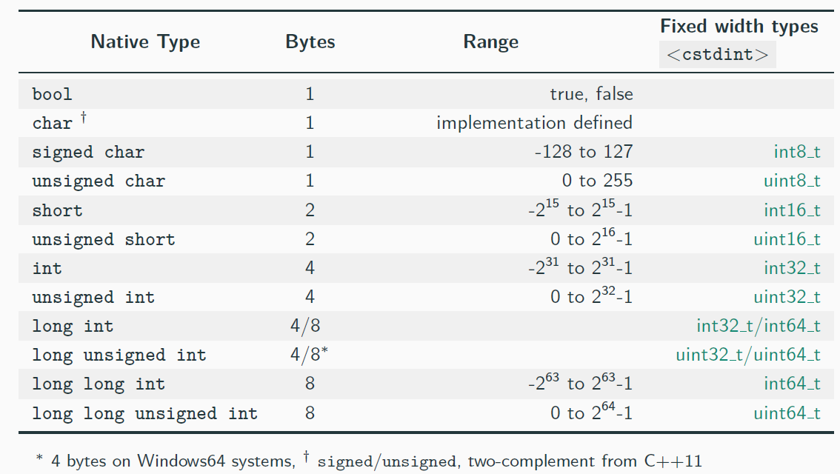
Arithmetic Types - Integral

Slide 6
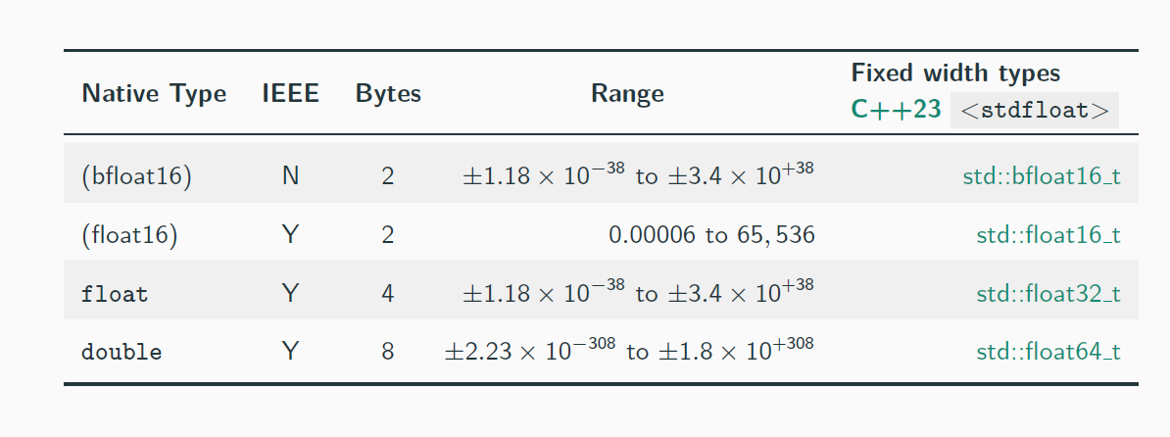
Arithmetic Types - Floating-Point
Notes:
bfloat16是什么？ https://blog.csdn.net/weixin_43301333/article/details/127332366

Slide 7
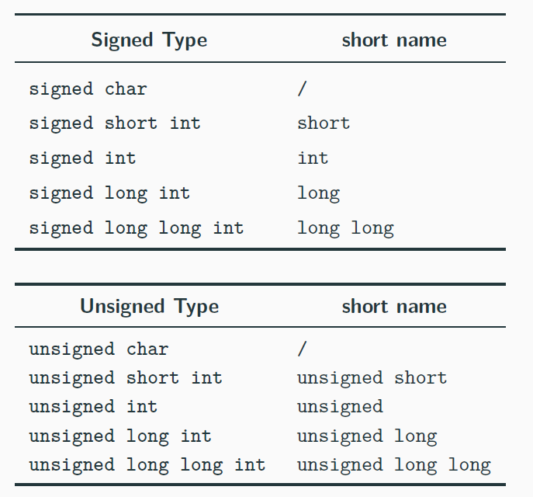
Arithmetic Types - Short Name

Slide 8
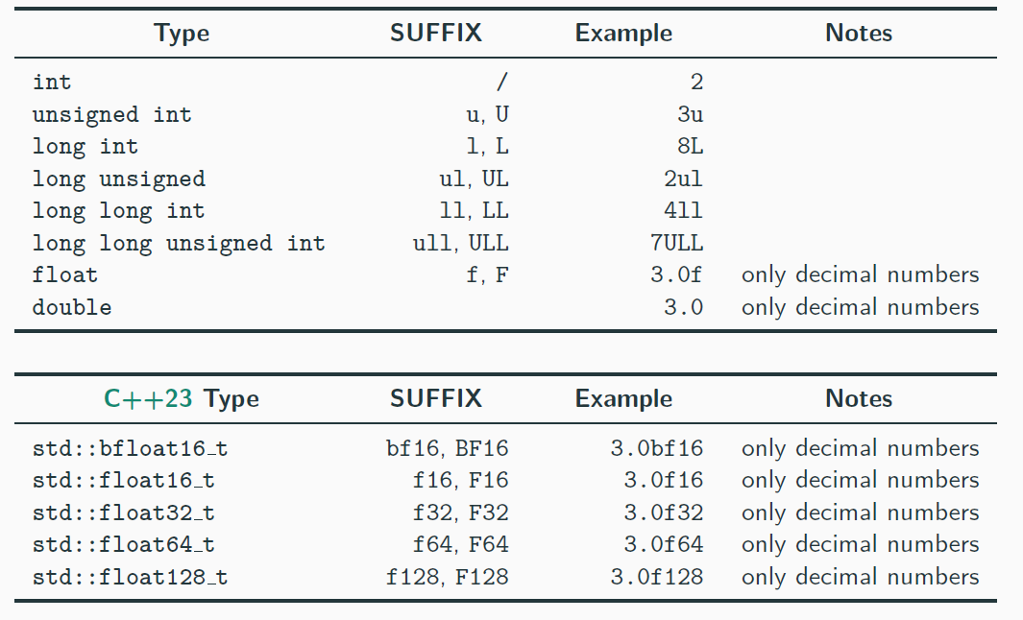
Arithmetic Types - Suffix (Literals)

Slide 9
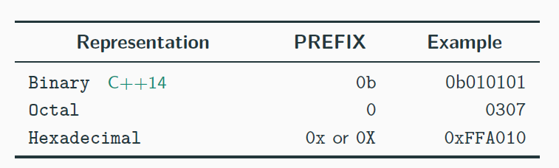
Arithmetic Types - Prefix (Literals)
C++14 also allows digit separators for improving the readability
1'000'000

Slide 10
Other Arithmetic Types
C++ also provides
long double
(no IEEE-754) of size 8/12/16 bytes
depending on the implementation
Reduced precision floating-point supports before C++23:
Some compilers provide support for half (16-bit floating-point) (GCC for ARM: LLVM compiler: half )
Some modern CPUs and GPUs provide half instructions
Software support: OpenGL, Photoshop, Lightroom, half.sourceforge.net
fp16 ,
C++ does not provide 128-bit integers even if some architectures support it.
clang and gcc allow 128-bit integers as compiler extension ( int128 )

Slide 11
void Type
void
is an incomplete type (not defined) without a value
•
void
indicates also a function with no return type or no parameters
e.g. void f() , f(void)
In C
sizeof(void) == 1
(GCC), while in C++
sizeof(void)
does not
compile!!
int main() {
// sizeof(void); // compile error
}

Slide 12
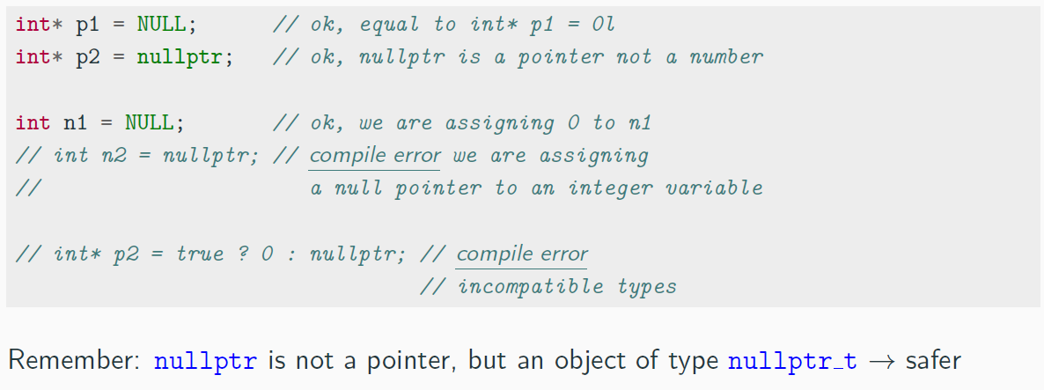
nullptr Keyword
C++11 introduces the new keyword
nullptr
to represent a null pointer ( 0x0 ) and
replacing the macro
NULL

Slide 13
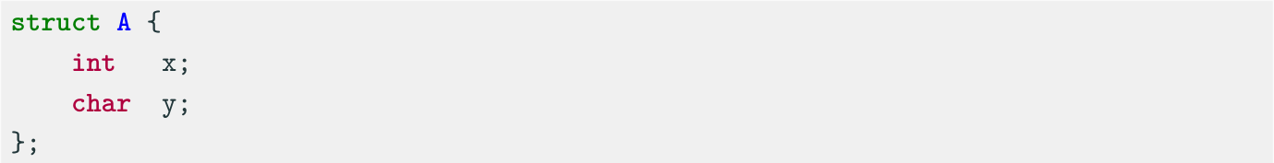
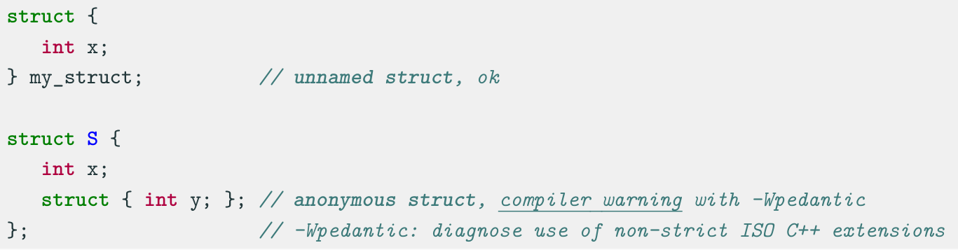
struct
A struct (structure) aggregates different variables into a single unit.
Unnamed struct: a struct without a name but with an associated type.
Anonymous struct: a struct without a name and type.

Slide 14
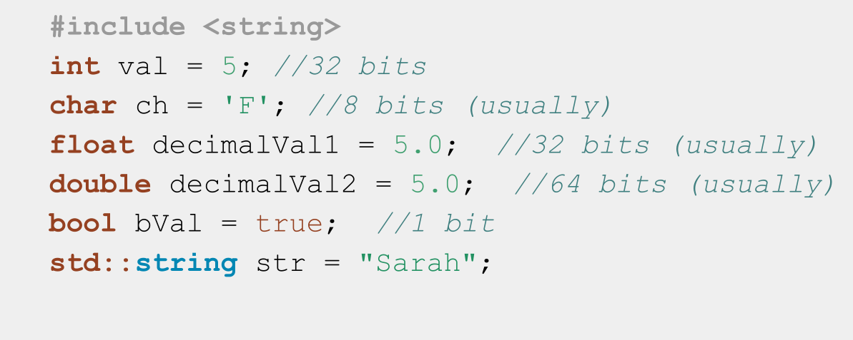
C++ Fundamental Types++

Slide 15
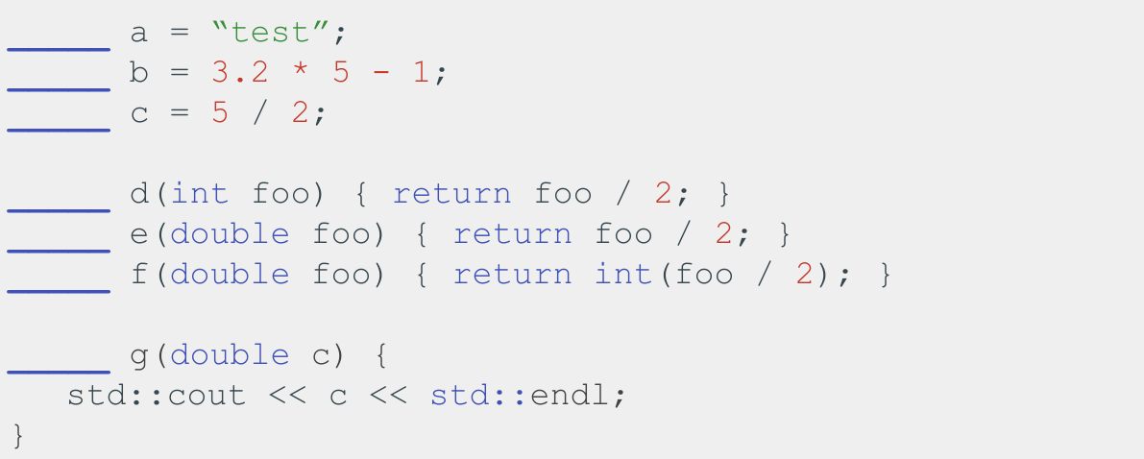
Fill in the types!

Slide 16
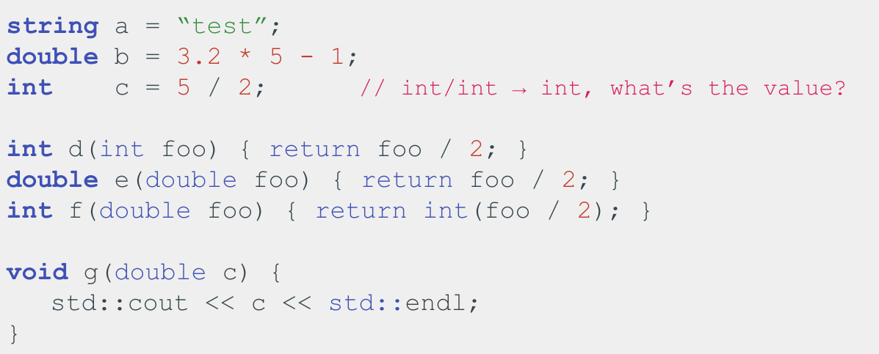
Fill in the types!

Slide 17
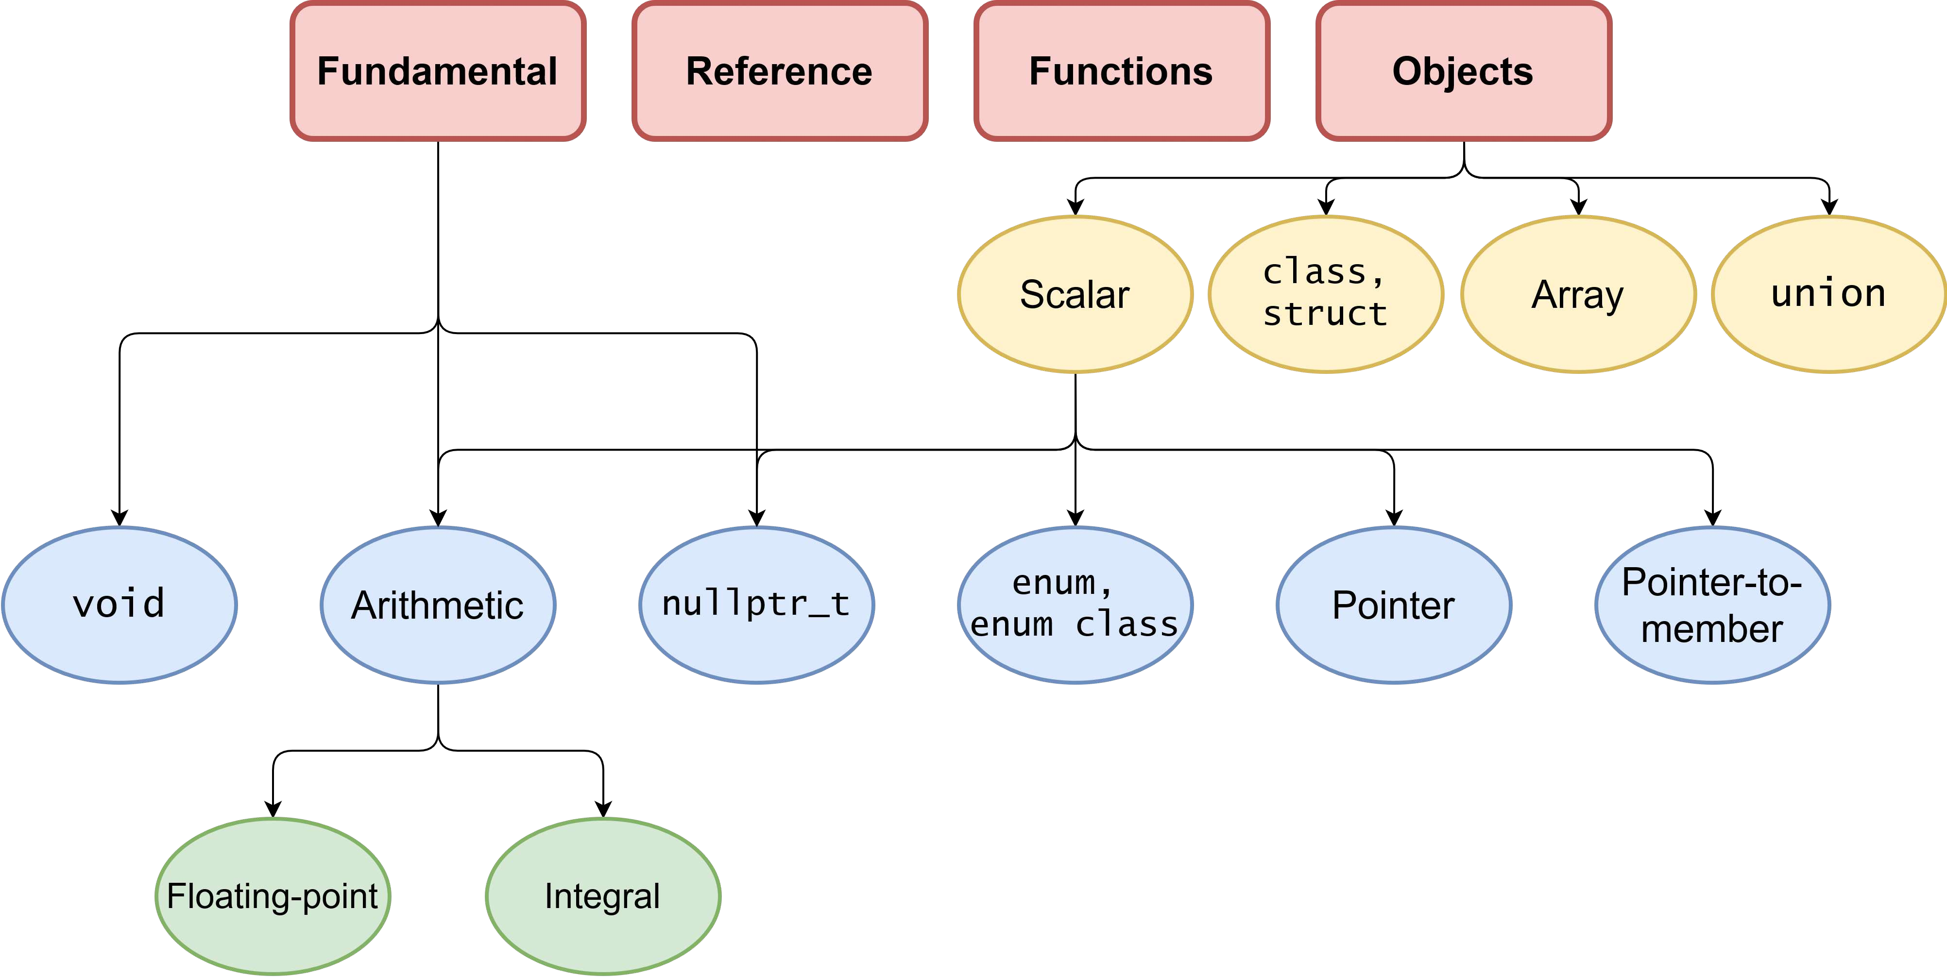
C++ Types Summary

Slide 18
Conversion Rules

Slide 19
Conversion Rules
Implicit type conversion rules, applied in order, before any operation:
⊗: any operation (*, +, /, -, %, etc.)
(A) Floating point promotion
floating type ⊗ integer type → floating type
(B) Implicit integer promotion
small integral type := any signed/unsigned integral type smaller than
int
small integral type ⊗ small integral type →
int
(C) Size promotion
small type ⊗ large type → large type
(D) Sign promotion
signed type ⊗ unsigned type → unsigned type

Slide 20
Examples and Common Errors
float f = 1.0f;
unsigned u = 2;
int i = 3;
short s = 4;
uint8_t c = 5; // unsigned char
f * u;
s * c;
u * i;
+c;
// float × unsigned → float: 2.0f
// short × unsigned char → int: 20
// unsigned × int → unsigned: 6u
// unsigned char → int: 5
Integers are not floating points!
int b = 7;
float a = b / 2;
int c = b / 2.0;
// a = 3 not 3.5!!
// again c = 3 not 3.5!!

Slide 21
Implicit Promotion
Integral data types smaller than 32-bit are implicitly promoted to int , independently if they are signed or unsigned
Unary and Binary
+, -, &, etc.
promotion:
+, -, ∼
char a = 48; // '0'
cout << a;
cout << +a;
cout << (a + 0);
uint8_t a1 = 255;
uint8_t b1 = 255;
cout << (a1 + b1);
// print '0'
// print '48'
// print '48'
// print '510' (no overflow)

Slide 22
auto Declaration

Slide 23
auto Keyword
C++11 The auto keyword specifies that the type of the variable will be automatically deduced by the compiler (from its initializer)
auto a = 1 + 2; // 1 is int, 2 is int, 1 + 2 is int!
// -> 'a' is "int"
auto b = 1 + 2.0; // 1 is int, 2.0 is double. 1 + 2.0 is double
// -> 'b' is "double"
auto
can be very useful for maintainability and for hiding complex type definitions
for (auto i = k; i < size; i++)
...
On the other hand, it may make the code less readable if excessively used because of type hiding
Example: in general makes no sense ( x is int )
auto x = 0;

Slide 24
auto Keyword - Functions ⋆
In C++11/C++14, (as well as decltype ) can be used to define function output types
auto
auto g(int x) -> int { return x * 2; } // C++11
// "-> int" is the deduction type. It means that return type is “int”.
// a better way to express it is:
auto g2(int x) -> decltype(x * 2) { return x * 2; } // C++11
auto h(int x) { return x * 2; } // C++14
//--------------------------------------------------------------
int x = g(3); // C++11

Slide 25
Initialization

Slide 26
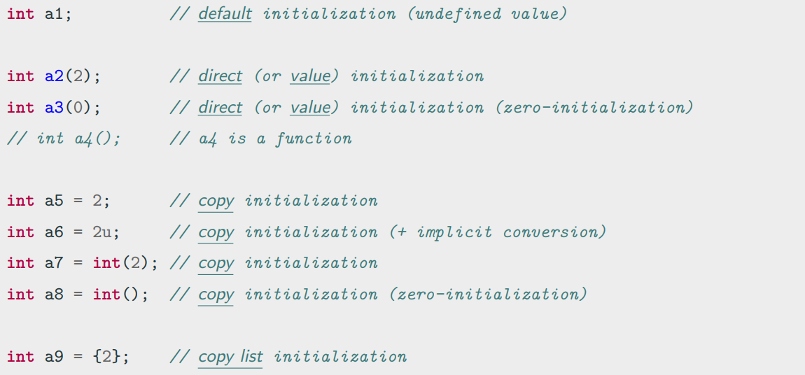
Variable Initialization

Slide 27
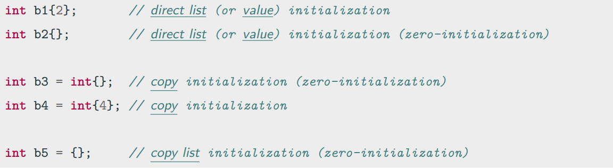
Uniform Initialization
C++11 Uniform Initialization syntax, also called brace-initialization or braced-init-list, allows initializing different entities (variables, objects, structures, etc.) in a consistent way:

Slide 28
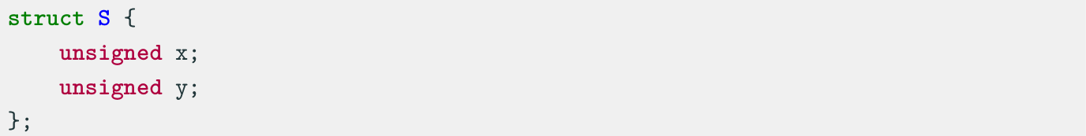
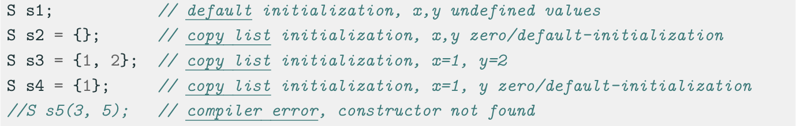
Structure Initialization
In C++ 03:
In C++ 11:
Notes:
narrowing conversion是指从一个大范围的数据类型转换为一个小范围的数据类型时可能会发生的数据丢失或截断

Slide 29
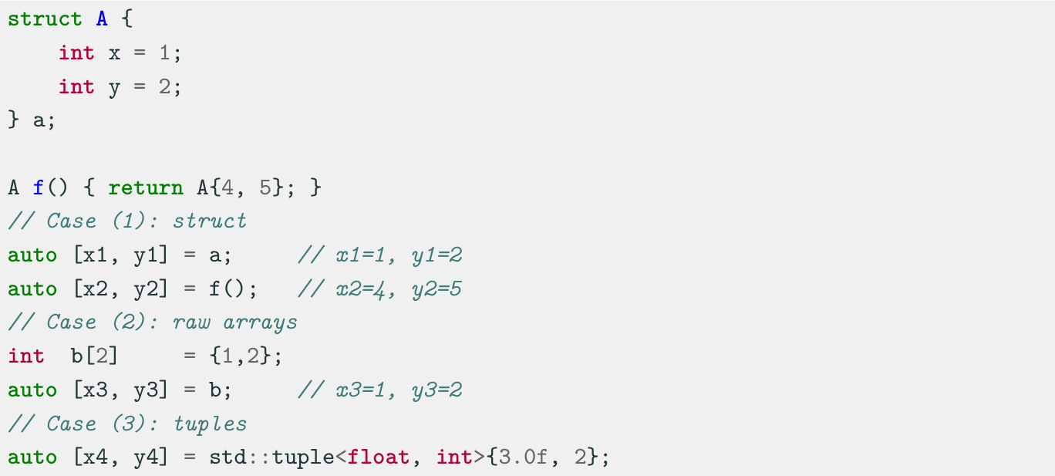
Structure Binding
Structure Binding declaration C++17 binds the specified names to elements of initializer:

Slide 30
Reference

Slide 31
Reference
A variable reference T& is an alias, namely another name for an already existing variable. Both variable and variable reference can be applied to refer the value of the variable.
A pointer has its own memory address and size on the stack, reference shares the same memory address (with the original variable).
The compiler can internally implement references as pointers, but treats them in a very different way.
Features:
References cannot have NULL value. You must always be able to assume that a reference is connected to a legitimate storage
References cannot be changed. Once a reference is initialized to an object, it cannot be changed to refer to another object
References must be initialized when they are created.

Slide 32
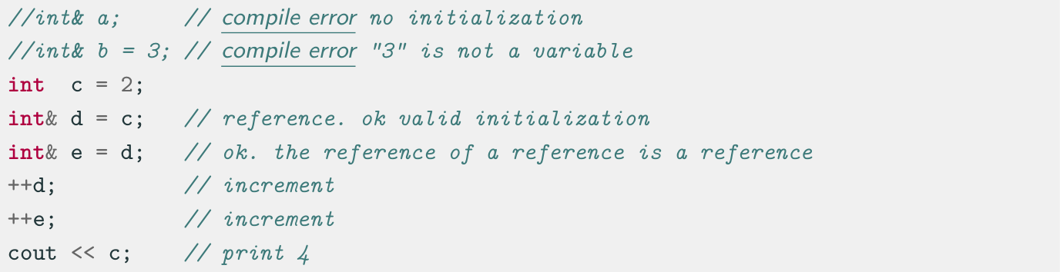
Reference - Examples
Syntax: T& var = …

Slide 33
l-values and r-values
l-value: An l-value can be to the left or the right of an equal sign.
Example:
r-value: An r-value can be only be to the right of an equal sign.
Example:
int a = 10;
int y = a; // a is an l-value
int a = 10; // 10 is an r-value

Slide 34
Const

Slide 35
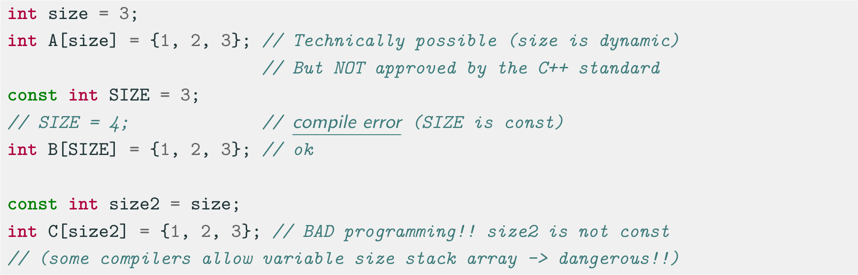
Const Keywords
The const keyword indicates objects never changing value after their initialization (they must be initialized when declared)
const variables are evaluated at compile-time value if the right expression is also evaluated at compile-time

Slide 36
const reference
Commonly, a reference type can’t be bind to a r-value, e.g. int& a = 3; // compile error (Because int& a is a l-value reference)
In this situation, we can use const reference:
More useful example:
int a = 5;
const int& const_ref_1 = 1;
const int& const_ref_2 = a;
int func_1(int& a) { return a * a; }
int func_2(const int& a) { return a * a; }
int main() {
// func_1(10); // compile error
func_2(10); // success
int a = 10;
func_1(a);
func_2(a);
return 0;
}

Slide 37
C++ Operators

Slide 38
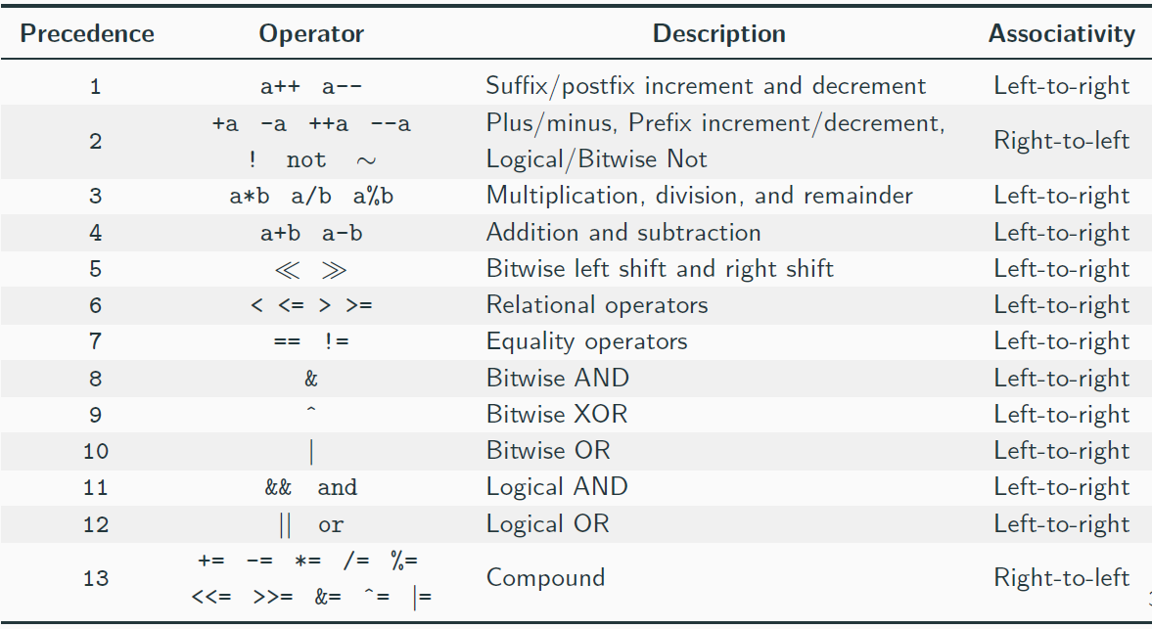
Operators Overview

Slide 39
Operators Precedence
Unary operators have higher precedence than binary operators
Standard math operators (+, *, etc.) have higher precedence than
comparison, bitwise, and logic operators
Comparison operators have higher precedence than bitwise and logic operators
Bitwise operators have higher precedence than logic operators
Compound assignment operators += , -= , *= , /= , %= , ˆ= , != , &= ,
>>= , <<= have lower priority
The comma operator has the lowest precedence
en.cppreference.com/w/cpp/language/operator precedence

Slide 40
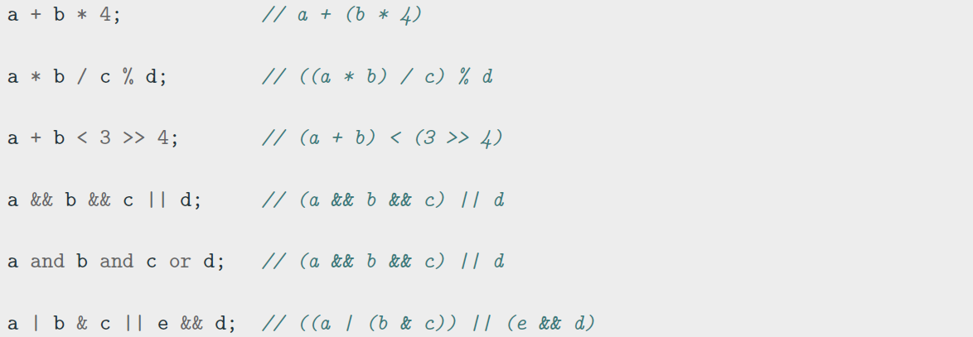
Operators Precedence
Examples:
Important: sometimes parenthesis can make an expression verbose... but they can help!

Slide 41
Prefix/Postfix Increment Semantic
Prefix Increment/Decrement ++i ,
--i
Update the value
Return the new (updated) value
Postfix Increment/Decrement i++ , i--
Save the old value (temporary)
Update the value
Return the old (original) value
Prefix/Postfix increment/decrement semantic applies not only to built-in types but also to objects

Slide 42
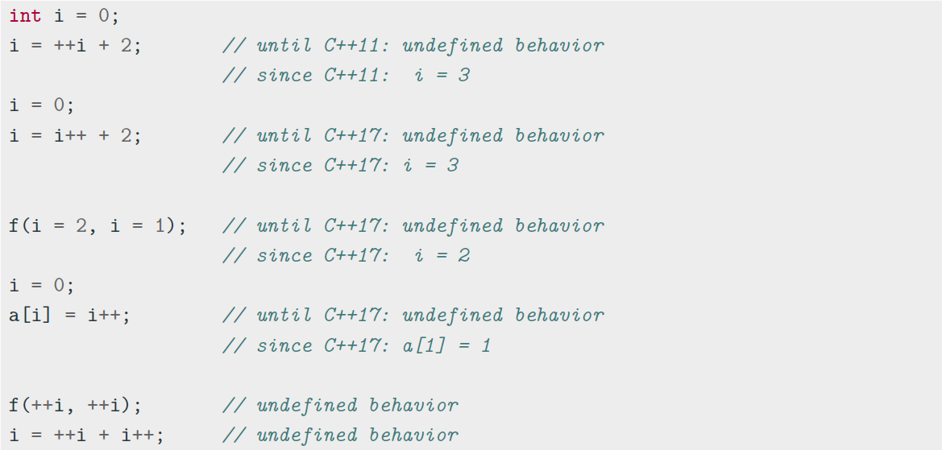
Operation Ordering Undefined Behavior ⋆
Expressions with undefined (implementation-defined) behavior:

Slide 43
Assignment, Compound, and Comma Operators
Assignment and compound assignment operators have right-to-left associativity
and their expressions return the assigned value
int y = 2;
int x = y = 3; // y=3, then x=3
// the same of x = (y = 3)
if (x = 4) // assign x=4 and evaluate to true
The comma operator⋆ has left-to-right associativity. It evaluates the left expression, discards its result, and returns the right expression
int a = 5, b = 7;
int x = (3, 4); // discards 3, then x=4
int y = 0;
int z;
z = y, x; // z=y (0), then returns x (4)

Slide 44
Spaceship Operator <=> ⋆
C++20 provides the three-way comparison operator <=> , also called spaceship operator, which allows comparing two objects in a similar way of strcmp . The operator returns an object that can be directly compared with a positive, 0, or negative integer value
(3 <=> 5) == 0; // false
('a' <=> 'a') == 0; // true
(3 <=> 5)
(7 <=> 5)
< 0; // true
< 0; // false
The semantic of the spaceship operator can be extended to any object (see next lectures) and can greatly simplify the comparison operators overloading

Slide 45
Coding to change the world
Qijun Zhao
qjzhao@scu.edu.cn

